Slide 1

Mozilla Firefox
Brenda Hsu, Ryan Languay, Anthony Plescia

Slide 2
Technology overview
Development began in 2002, first version released in 2004
Primary coding language: C++/C (backend)
Extensions written in XUL (UI changes) and JavaScript (behaviour)
Code base shared with rest of Mozilla; few non-Mozilla libraries used
Internal build system (mostly Python)

Slide 3
Discovery Process
Open Source Browser → Documentation was very extensive and helpful
Wrote Scripts using Powershell to analyze code-base
Detailed Documentation by Mozilla helped us figure out what API’s Firefox used

Slide 4
Metrics
Number of lines of code (C++, C, JavaScript) | 16322309
Number of lines of comments | 51404
Functions (C++) | 4846
Objects (C++) | 2253
Programming Languages | C++, C, JavaScript
Number of libraries (in lib folder) | 65
Library : core ratio | 571628132:79606676
Slowest code portion | Gecko subsystem
Compile time | Approx. 60 minutes (Windows 10)
Distribution info | Release 49.0.2

Slide 5
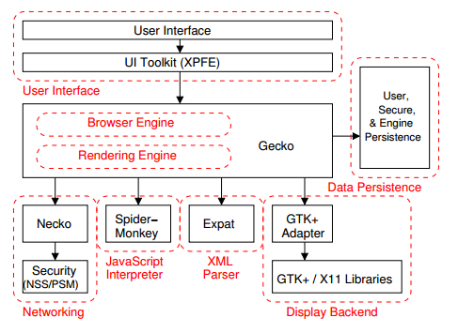
Architectural styles
Overall system: layered architecture
Structured communication between various layers of abstraction
Lower layers are more reusable (reused across Mozilla projects)
http://research.cs.queensu.ca/~emads/teaching/readings/emse-browserRefArch.pdf

Slide 6
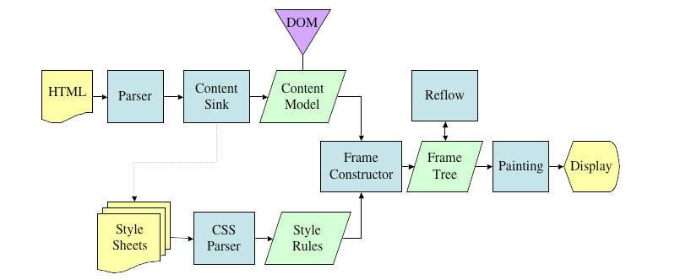
Architectural Styles
Gecko subsystem – batch sequential architecture
Gecko receives HTML document from Necko (networking)
Parses document into DOM tree, renders to screen with styling
https://developer.mozilla.org/en/docs/Introduction_to_Layout_in_Mozilla

Slide 7
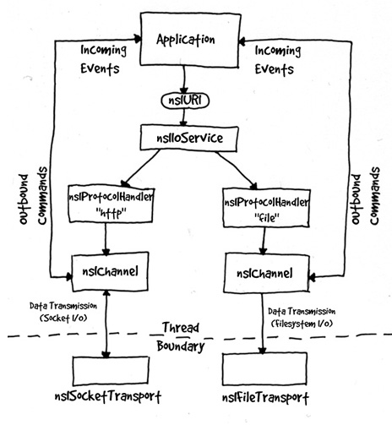
Architectural Styles
http://www-archive.mozilla.org/projects/netlib/neckoArch.html
Necko subsystem – Pipe & Filter architecture
Requests are processed in streams in Necko
Necko subsystem – Message-based architecture
Connection requests are made in an asynchronous and buffered fashion
Improves performance in Necko code, using multithreading
Necko subsystem – Master-slave architecture
Single master thread, several sub-threads

Slide 8
Design Patterns
Singleton
Several examples, including CookieService (static class in Necko)
Proxy
Several classes accessed via proxy, including nsCORSListenerProxy
Good for simplifying data access and security
Factory
nsWidgetFactory, but even more generic with macros

Slide 9
Critical Analysis -- Benefits
Firefox is Platform Independent
Due to its architecture’s reusable components, Firefox has been ported to and is available on most popular Operating Systems, leading to an often consistent user experience.
Firefox is maintainable
Layered Architecture
Components are restricted to only communicate with certain layers. Changes don’t usually affect the entire code base.
Firefox is extensible
Many extensions are available
Extensions are independently built – can be easily installed and removed
Extensions can add a lot of interesting functionality not initially available

Slide 10
Critical Analysis -- Drawbacks
In some areas, Firefox can be difficult to maintain
A lot of dependencies throughout the browser
If one API or library breaks, the browser could break
Openness can lead to performance issues
Extensions are easily developed by users and uploaded to the Firefox Store
Open Nature can lead to user-created extensions bogging down browser performance

